Slide 1
Improv Technology for VoIP

Slide 2
The Improv Advantage
Breakthrough configurable DSP architecture
Industry’s most efficient DSP and compiler combination*
Industry’s most versatile DSP to meet designer’s application specific needs
  Black-box Application Cores for Media Processing and VoIP
  Highly Flexible Design methodology & development environment
  Complete SoC integration and methodology
Industry’s only high level language based multi-processor DSP architecture
Highest MIPs/mm² – Lowest power/MIP
Optimized application support for key DSP markets
Proven technology
Jazz DSPTM is the first and only truly configurable DSP !
*Certified by EEMBC

Slide 3
Improv’s Key Value Proposition
Improv’s technology allows our customers to rapidly create highly competitive solutions for high volume application markets
High Performance Applications
  Create application-optimized processing engines for your target market
  Instruction-level parallelism combined with custom instructions/accelerators
Rapid Time-to-Market Deployment
  Rapid methodology to design advanced processing engines
  Create application-optimized processing engines specific to your needs
  Fully automated path from application to implementation
Enables Design for Profit
  Lowest performance to power ratio versus any product on the market
  Control balance between performance and die size
  Programmability allows multiple products from a single die

Slide 4
Product Portfolio
Core Processor
Technology
Jazz DSP
Processor
Jazz PSA Standard
Jazz PSA Composer
Jazz PSA Rehearsal Boards
Tool Suites and
Development Boards
“Crescendo” - Media Processing
“Acappella” - Voice-Over IP & Packet
“Tempo” – Wired & Wireless LAN
Application
Solution Kits

Slide 5
Improv Product Application Kits
Improv AcappellaTM – Voice Over IP & Packet Solutions
  G.72x codecs, G.168 echo cancellation, complete voice processing framework
  Customer-Proven – Philips, NeoPace, ITRI, KLSI, TelGen
  Acappella HomeTM and Acappella IADTM have been delivered and implemented in silicon today
Improv CrescendoTM – Media Processing for Consumer Devices
  MPEG4, MPEG2, Dolby Digital (AC-3), JPEG, JPEG2000 Video solutions completed
  MP3, AAC, AACv2 and AMR - Audio solutions completed
  Lead customer projects have been delivered and implemented in silicon today
Improv TempoTM – Wired and Wireless LAN Connectivity
  In partnership with HelloSoft and Industry Leaders
  802.11 a, b & g standards supported
  Multiple lead customers in process

Slide 6
Improv “Acappella” Solution Overview
Key Benefits
  2 Channel IP Video Phone solution (Voice & Video) at 40 MHz < 200K gates
  4 Channel Home Solution at 60 MHz and < 150K gates
  12-32 Channel IAD Solution at (16 Channels @ 100 MHz and < 200K gates)
  1024 channels for CO solutions available in Single Chip platform
  Full voice processing system including voice codecs, echo cancellation, dial-tone management and call control
  Complete Application Software (source code included) developed by Improv
  SoC Integration Components including; ARM/MIPS interfaces and TDM interface (connect directly to SLIC/SLAC)
  Complete Reference System and Verification Environment
Various Configurations
  Residential Gateways for Home and SOHO products – 2-4 channels with fax and CLEC
  12-32 Channel Integrated Access Devices for T1 or DSL and direct PBX connections
  Central Office Gateways with thousands of channels
  Advanced IP Phones including multi-channel conferencing and on-phone echo cancellation

Slide 7
Acappella IP Video Phone & Home Solution
Complete Reference Design for IP Video Phone
  2 – 4 Channel Video Phone Solution
  Support for your chosen host processor (ARM, MIPS, OpenRISC)
  Protocol stacks available from industry partners
Acappella Video/Voice Processor Core
  Low power, high performance
  Multiple video codecs - H264/AVC, H263, MPEG4 SP
  Full voice processing system including voice codecs, echo cancellation, dial-tone management and call control
  Host bus and TDM interfaces for direct connection to on-chip bus (AMBA, OCP, Wishbone) and SLIC/SLAC interfaces

Slide 8
Acappella IP Video Phone & Home Core
Time-Slot
Interchange
Voice A/D
Jazz
HBI
AMBA/
OCP/
Wishbone
Bus
Host Bus Interface
Shared
Memory
Shared
Memory
2 Channels @ 40 MHz
200K Gates + 30 Kbytes Data + 125 Kbytes IM
30 mW (gates ~ not including memories)
Host Interface Controller
Acappella Processor
Control Bus
Custom Jazz DSP optimized for Video, Voice & Echo
  Dual ALUs, Dual MACs, Shifter
  Video/Voice Accelerators

Slide 9
Acappella IAD Solution
Complete Reference Design for Integrated Access Devices (IAD)
  12-32 Channel IAD Solution
  Support for your chosen host processor (ARM, MIPS, OpenRISC)
  Protocol stacks available from industry partners
Acappella Voice Processor Core
  Low power, high performance
  Complete suite of G.711/G.72x codecs
  Full voice processing system including voice codecs, line echo cancellation, dial-tone management and call control
  Support for advanced conferencing, IAD chaining and multiple bus interfaces
  Host bus and TDM interfaces for direct connection to on-chip bus (AMBA, OCP, Wishbone) and SLIC/SLAC interfaces

Slide 10
Acappella IAD Core
I/O Pins
Jazz HBI
Jazz
TSI
16 Channels @ 100 MHz
215K Gates + 40 Kbytes Data + 64 Kbytes IM
40 mW (gates ~ not including memories)
I/O Pins
Host Bus
Shared
Shared
Shared
Memory
Memory
Memory
Memory
Interface
Host
Jazz
Jazz
Voice
Interface
Voice
Echo
Processing
Controller
System
Control Bus
2 Custom Jazz DSPs, one customized for voice, one for echo cancellation
  Dual ALUs, Dual MACs, Shift, DDCU’s
16-32 channels of G.726/G.711 with G.168 echo (programmable tail length)
Silicon-proven (Acappella IAD chip, KLSI .18um process)

Slide 11
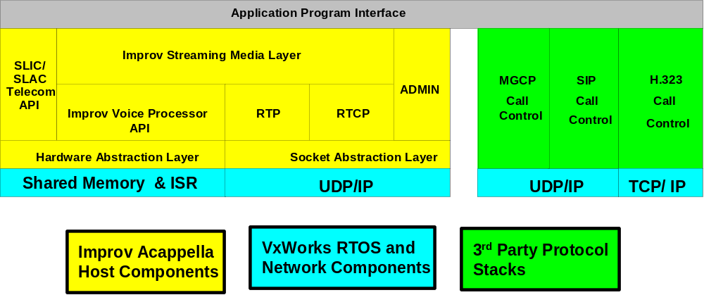
Host Software Stacks
Common Framework for Linux and other popular OS (e.g. Linux, VxWorks)
Acappella VPS presents an API to the RTOS for DSP function calls
MGCP, MEGACO, SIP and H.323 standards for call control available from third parties
  Application Partners
  General - HelloSoft
  Protocol Stacks - Hughes Network Systems, Radvision, Jungo
  RTOS – WindRiver VxWorks

Slide 12
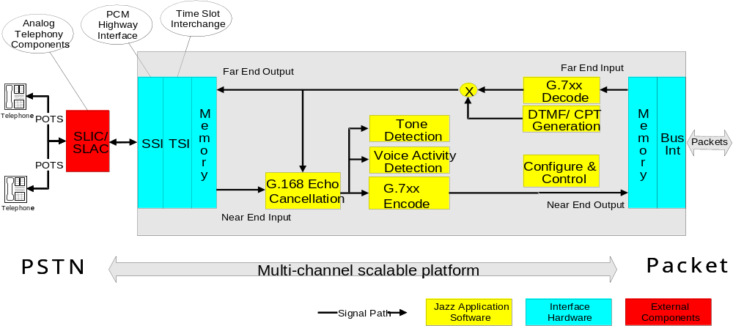
Acappella Voice Architecture
Streaming Media Layer, TDM Highway Support
Speech Coding – G.711, G.726, G.729ae, G.728i, G723.1
Echo Cancellation – G.168 with programmable tail length
Voice Processing System – DTMF/CPT/V.18, VAD/CNG, Caller-Id, Conferencing, etc.

Slide 13
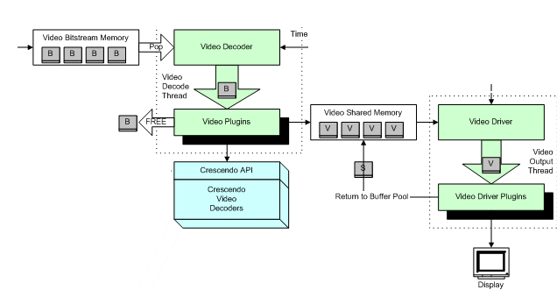
Acappella Video Architecture (IP Video Phone only)
Multichannel Video Software Framework
Full Control, Configuration and Interrupt API
Video Codecs – H264/AVC, MPEG4 SP, H263

Slide 14
Key Software Components Supported
Available Component | Avg. MIPS | Acappella IP Phone | Acappella Home | Acappella IAD | Acappella CO | Description
G.711 Codec | 0.5 | √ | √ | √ | √ | PCM Speech Codec
G.726 Codec | 3.1 | √ | √ | √ | √ | ADPCM Speech Codec
G.729 (a, e) Codec | 8.7/11.1 | √ | √ |  | √ | CS-ACELP Speech Codec
G.728 (I) Codec | 13.2 | √ |  |  | √ | LDCELP Speech Codec
G.723.1 Codec | 8 | √ |  |  |  | Dual-rate Speech Codec
G.165/G.168 | 3.7 (16 ms) 5.9 (32 ms) | √ | √ | √ | √ | Digital Network echo cancellation
Fax | n/a | √ | √ | √ | √ | Automatic detection and pass through
Tone Handling | 2.1 | √ | √ | √ | √ | DTMF Detection and Generation, Call progress tones, V.18
VAD/CNG | .03 | √ | √ | √ | √ | Voice Activity Detection and Comfort Noise Generation
Caller-id | .015 | √ | √ | √ | √ | Caller id generation
Conferencing | n/a | √ | √ | √ | √ | Multi-channel conferencing support

Slide 15
Improv Application Solution Kit Overview
Complete hardware/software solution bundle for a target application
  Rapid development of advanced chip capabilities
  Rapid entry into high-value markets
  Custom processor cores created using the Jazz DSP Composer™ including hardware accelerators and custom instructions (DDCUs)
Full source descriptions and configuration capabilities for both hardware and software
  Software modules for key media components
  Software framework including complete host API to interact with the DSP core
  Create additional value-added capabilities and features
  Integration with other aspects of a complete SoC; e.g., memory controllers, custom interfaces
Robust SoC Integration Platform
  Direct support for major on-chip buses including multi-layer AMBA™ (AHB)
  DMA and Memory Interfaces for high-speed memory connections
  Host software package provides ANSI-C API for configuring, controlling and running application modules

Slide 16
SoC Integration Package
Improv provides a complete SoC integration package to fully support its
uniquely configurable architecture
H/W Integration Blocks
  Host Bus Interface (JazzHBITM) – Support for AMBA, MIPS and custom busses
  Data Channel Interface (JazzDCITM) – Off-core memories and DMA control
  Time-Slot Interface (JazzTSITM) – Time-division multiplex (TDM) interface to data
  Serial Stream Interface (JazzSSITM) – Serial data interface
H/W Debug Integration
  Integration of JTAG on-chip debug interface with other SoC blocks
Host Software Layer
  Streaming media interface and application-specific APIs for RTOS and processor software support
System-level Verification Environment for co-execution with other SoC blocks

Slide 17
SoC Integration Blocks
Processor Host Bus Interface (HBI)
  Mailbox-style communication between host and Acappella core
  Different configurations supporting AMBA, OCP, Wishbone and generic busses
Processor Time Slot Interchange (TSI)
  Direct connection to time division multiplexing of different voice channels
  Channel characteristics fully configurable through host API
Processor Data Channel Interface (DCI)
  Smart data management for video frame data
  Connection to on-chip bus or direct to memory

Slide 18
HW/SW – VoIP Video Phone Reference Design
User Interface
System Demux
Video Codec
Protocol
Media
Voice Codecs
LEC
RTOS
(Linux, Vx-Works)
VPS
Processor
Socket
(ARM, MIPS)
HBI
Acappella
for
Video Phones
TSI
LAN
(Ethernet,
PCI, ATM)
SLIC/SLAC
On-Chip Bus
AMBA, OCP, Wishbone

Slide 19
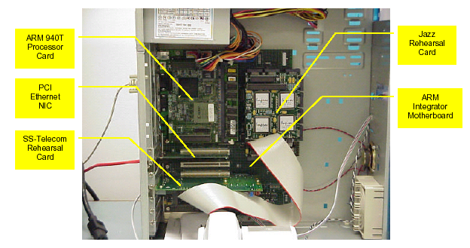
Prototyping Environment for VoIP Reference Designs
Acappella Solution Kit w/Jazz PSA Platform
Improv Rehearsal Board
  Rehearsal XE2 series (PCI for MIPS Malta)
  Telephony Daughter Card
Host Platform (optional)
  ARM Integrator or
  MIPS Malta
Host Software
  Linux 2.6
  Wind River VxWorks
  Radvision H.323

Slide 20
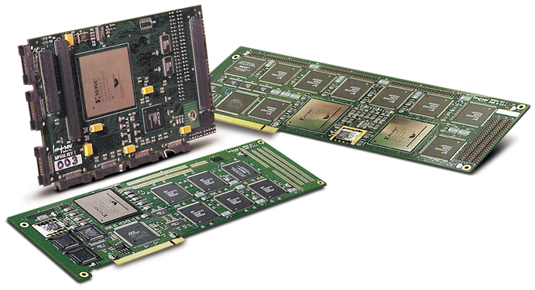
Jazz PSA RehearsalTM Development Boards
Processor and System Verification
  Jazz PSA RehearsalTM XE2-6K
  Dual FPGA (2-4 processor)
  configuration; PCI-based
  Map “Composed” JazzTM processors onto FPGA technology, execute and test application code - includes full debugger support
  Use same test bench for functional, ISS and RehearsalTM board simulation
  Windows NT drivers – Multiple Configurations
  Standard Host PC – PCI bus support
Integrated Development Boards for RISC/DSP Development
  MIPS Malta Development Board integration

Slide 21
Acappella Performance Summary
Low power, high performance cores for immediate integration into IP videophone, Home VoIP and IAD products; just add standard components
Support for rapid integration into SoC designs using your chosen host processor (ARM, MIPS, OpenRISC), protocol stacks and streaming media software
Fully programmable solution and scalable solution enables value-added differentiation and future evolution of product
Improv is your partner in getting to market quickly through solid support and full-chip design services

Slide 22
Improv Business Model
IP Licensing
  Pay per design start rather than costly multiple use licenses
  Design start license fee with both royalty and non-royalty options
Tool Licensing
  Jazz Composer tool suite for creating your own custom application processors
  Low cost Jazz Standard Tool Suite for software development tools for you and your customers
Solution Kit Licensing
  Non-royalty one-time license fee for solution kits including source code
  Does not cover chip royalties due for standards (e.g., MPEG4, G.72x, …)
Rehearsal Boards and On-Chip Debug Interface
  Rehearsal boards available from Improv
  FSA box supports JTAG on-chip debug interface

Slide 23
Conclusions
Improv’s Configurable VLIW DSP processor architecture provides high performance processing engines and rapid design methodology to meet aggressive Time to Market requirements
Flexible – programmable architecture meet the needs of broad application support and firmware upgradeability
Complete Software Solution kits for vertical markets
Integration and implementation tools and methodology
Silicon implemented and customer proven technology

